Slide 1
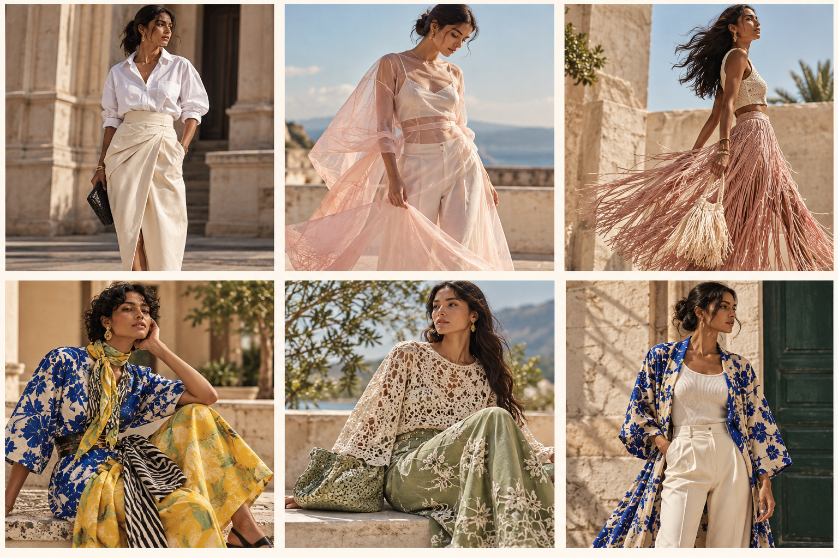
SPRING / SUMMER 2027 • WOMENSWEAR
EXPRESSIVE
EASE
A trend forecast built on runway intelligence, buyer signals and India market translation.
THE STRATEGIC THESIS
Expressive details on wearable foundations — not maximalism or minimalism alone.
RESEARCH CUT: 22 OCTOBER 2026
AI-GENERATED CONCEPT VISUALS • NOT RUNWAY PHOTOGRAPHY

Slide 2
01 / EXECUTIVE SYNTHESIS
The SS27 proposition
What the runway and buyer evidence suggest — and how to translate it into a product story.
EXPRESSIVE EASE
THE HERO
THE FEELING
THE TWIST
SS27 is best read as a dual movement: statement-making color, embellishment and proportion sit beside a growing appetite for lighter, versatile wardrobe pieces.
Skirt-led separates: strongest combined runway index and buyer corroboration.
Lightness, sheer layers and touchable materials help make expression feel easy.
Print, fringe, lace, crochet and waist details add personality to a simple base.
The commercial opportunity is to sell the expression without requiring a complete runway look: start with a skirt, blouse, layer or accessory that refreshes the customer's existing wardrobe.
WHAT MAKES THIS FORECAST CREDIBLE
Quantitative runway signal: T-Fashion's indexed SS27 dataset tracks 12,320 looks across 359 designers.
Buyer corroboration: Vogue Business interviews highlight skirts, color, embellishment, sheerness and craft.
India lens: Le Mill's Mumbai buyer emphasizes separates, construction, comfort and wardrobe utility.
SCOPE NOTE: Consumer-search analysis is outside the project scope; this is a runway and buyer-intelligence forecast.
02
SS27 | EXPRESSIVE EASE | SOURCES IN FINAL SLIDE
02
SS27 | EXPRESSIVE EASE | WORKING FORECAST

Slide 3
02 / EVIDENCE DASHBOARD
What changed on the SS27 runway index
Selected third-party tagged-look shares, compared with SS26. Directional evidence; not sales or consumer demand.
12,320
359
317
18 OCT 2026
LOOKS INDEXED
DESIGNERS
TRENDS TAGGED
INDEX UPDATE
Straight skirts
5.1% → 10.3%
SS26 → SS27
Florals
11.4% → 14.2%
SS26 → SS27
White
23.7% → 28.4%
SS26 → SS27
Dropped dresses
0.6% → 4.9%
SS26 → SS27
Interpretation: skirts, floral patterning and white/lightness have measurable upward signals inside this indexed dataset. Dropped-waist dresses are an emerging silhouette challenger worth monitoring.
03
SS27 | EXPRESSIVE EASE | SOURCES IN FINAL SLIDE
03
SOURCE: T-FASHION RUNWAY INDEX, SS27, UPDATED 18 OCT 2026

Slide 4
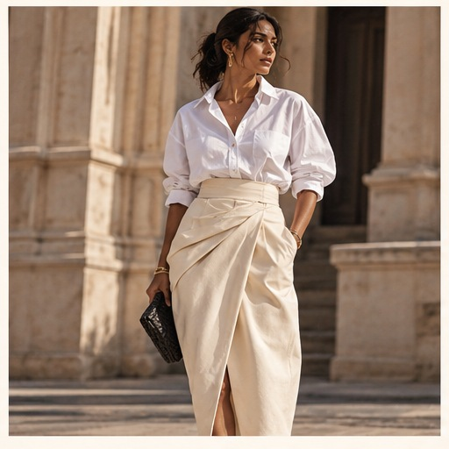
03 / TREND 01
The skirt becomes the wardrobe engine
Hero direction | separate-led dressing | high styling mileage
RUNWAY SIGNAL
Straight skirts rose from 5.1% to 10.3% of indexed looks from SS26 to SS27. Vogue Business buyers also repeatedly named the skirt as a key product opportunity.
PRODUCT LANGUAGE
COMMERCIAL TRANSLATION
• Satin A-line midi
• Straight skirt
• Pleated / panelled skirt
• Poster-print statement skirt
• Build outfits around one hero bottom
• Pair with shirts, tanks and light knits
• Offer both simple and embellished versions
Portfolio call: prioritize skirts as the capsule anchor; show versatility through styling, not just a single runway look.
Visual: AI-generated concept illustration, not designer runway imagery.
04
SS27 | EXPRESSIVE EASE | SOURCES IN FINAL SLIDE
04
SOURCES: T-FASHION SS27 INDEX; VOGUE BUSINESS BUYER REPORT, 14 OCT 2026

Slide 5
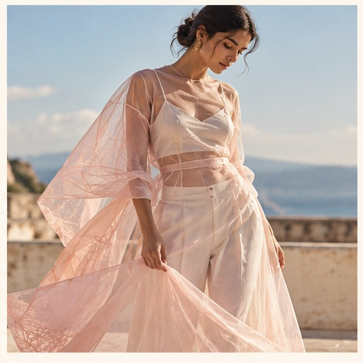
04 / TREND 02
Lightness is a construction strategy
Sheer, semi-sheer and fluid layers — reveal / conceal, not exposure alone.
The season's response to heat is visible in color, transparency and weightlessness.
Vogue's SS27 runway synthesis describes lightness across fabric weight and visual transparency. Buyer commentary frames sheerness as layering and ease as much as sensuality.
FABRICS
STYLING
Voile, chiffon, organza, lace, lightweight cotton and linen blends.
Semi-sheer top over a base; shirt over a tank; layer lengths deliberately.
India adaptation: breathable layers, opaque base options, sleeve/length variants and occasion-specific coverage.
AI-GENERATED CONCEPT VISUAL
05
SS27 | EXPRESSIVE EASE | SOURCES IN FINAL SLIDE
05
SOURCE: VOGUE SS27 RUNWAY TRENDS; VOGUE BUSINESS BUYER REPORT

Slide 6
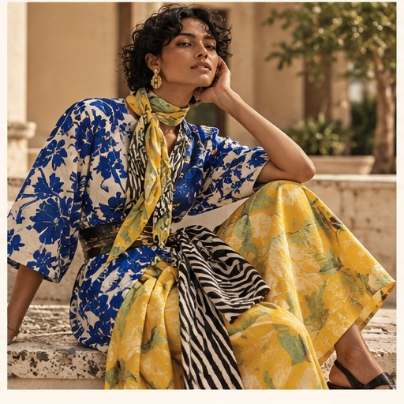
05 / TREND 03
Expression returns through color and print
The opportunity is controlled contrast, not a head-to-toe costume.
Florals rose from 11.4% to 14.2% of indexed looks.
Buyer commentary also highlights poster prints, mixed and clashing patterns, rich color and bright primary color combinations.
COLOR STORY
Cobalt
Citrus
Blush
Sage
Product play: one printed skirt or co-ord paired with a calm base; offer the repeat pattern as an accessory or top to lower adoption risk.
AI-GENERATED CONCEPT VISUAL
06
SS27 | EXPRESSIVE EASE | SOURCES IN FINAL SLIDE
06
SOURCES: T-FASHION SS27 INDEX; VOGUE BUSINESS BUYER REPORT

Slide 7
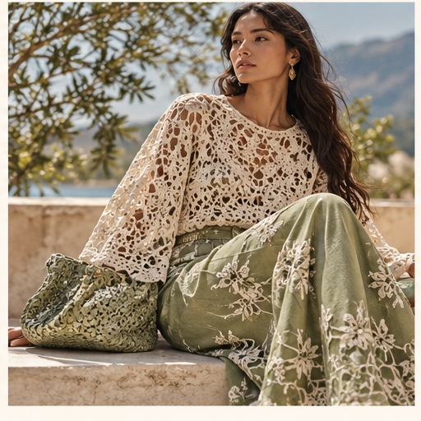
06 / TREND 04
Tactility makes the statement feel personal
Craft, crochet, lace, embroidery, beads and fringe act as emotional detail.
A material-led story with multiple intensity levels.
LOW-COMMITMENT: crochet panel, embroidered cuff, textured bag.
MID-LEVEL: lace-trim blouse, openwork knit, beaded collar.
STATEMENT: fringe skirt or embellished set for event-led dressing.
Buying principle: the detail should change the feeling of the outfit without making the whole item difficult to wear or care for.
AI-GENERATED CONCEPT VISUAL
07
SS27 | EXPRESSIVE EASE | SOURCES IN FINAL SLIDE
07
SOURCE: VOGUE BUSINESS BUYER REPORT, 14 OCT 2026

Slide 8
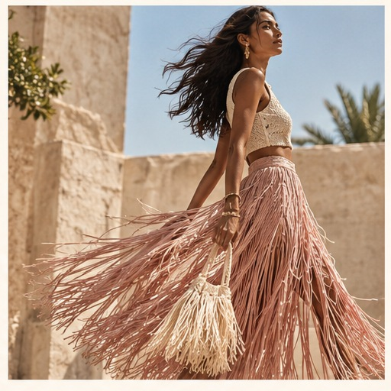
07 / TREND 05
Shape is created through proportion and styling
Cinched waist, sash belts, layered volume — with dropped-waist silhouettes as a counterpoint.
The season is not one silhouette; it is a new toolkit for shaping the body.
DEFINED WAIST
DROPPED WAIST
Wide belts, fabric sashes, peplum-like shape and adjustable tie details.
A clear runway-index riser; use as an exploratory dress silhouette.
PRODUCT APPLICATIONS
• Detachable tie belt or sash
• Relaxed dress with adjustable waist
• Volume-balanced top + skirt
• Accessories that change outfit proportions
AI-GENERATED CONCEPT VISUAL
08
SS27 | EXPRESSIVE EASE | SOURCES IN FINAL SLIDE
08
SOURCES: VOGUE BUSINESS BUYER REPORT; T-FASHION SS27 INDEX

Slide 9
08 / MACRO SYNTHESIS
Maximalism meets elevated essentials
SS27 is a productive contradiction: more personality, but not necessarily more effort.
EXPRESSIVE
ELEVATED ESSENTIALS
Color • pattern • fringe • lace • embellishment • unusual proportions
EXPRESSIVE EASE
Fluid shirts • practical separates • relaxed tailoring • versatile base layers
The product formula: one statement element + two or three easy foundations. This captures the season's creative charge while keeping the wardrobe useful.
Evidence nuance: T-Fashion reports minimalism rising as well as glam; treat these as coexisting signals, not mutually exclusive camps.
SS27 | EXPRESSIVE EASE | WORKING FORECAST
09

Slide 10
09 / VISUAL DIRECTION
Palette & material language
A warm, wearable ground lets the expressive accents do the work.
CHALK
INK
BLUSH
CITRUS
COBALT
SAGE
#EEE7DA
#19283B
#DFAFBC
#E9C84E
#3F60AE
#A6B59C
MATERIAL DIRECTION
• Fluid satin, cotton poplin, linen blend
• Voile, chiffon, lace and semi-sheer overlays
• Openwork crochet and embroidery
• Fringe/beading as selective accent
PALETTE / TEXTURE COLLAGE — CONCEPT ART
10
SS27 | EXPRESSIVE EASE | SOURCES IN FINAL SLIDE
10
SS27 | EXPRESSIVE EASE | WORKING FORECAST

Slide 11
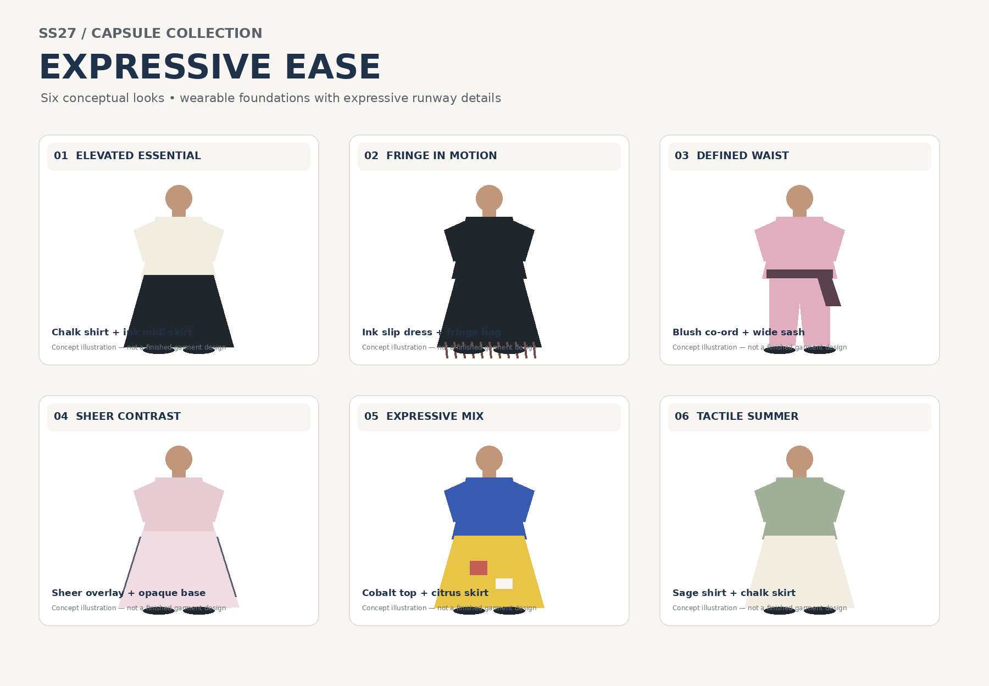
10 / PRODUCT TRANSLATION
Six-look capsule: one idea, six ways to wear it
Conceptual look directions; not finished garment specifications or runway replicas.
01 / Elevated essential
02 / Fringe in motion
Chalk shirt + ink midi skirt
Ink slip dress + fringe bag
03 / Defined waist
04 / Sheer contrast
Blush co-ord + wide sash
Sheer overlay + opaque base
05 / Expressive mix
06 / Tactile summer
Cobalt top + citrus skirt
Sage shirt + chalk skirt
Styling brief: pair each look with the capsule styling PDF for materials, fit and commercial notes.
11
SS27 | EXPRESSIVE EASE | SOURCES IN FINAL SLIDE
11
SS27 | EXPRESSIVE EASE | WORKING FORECAST

Slide 12
11 / INDIA MARKET LENS
Translate the direction to product, not stereotype
Prioritize comfort, modularity and occasion flexibility; validate by city, customer and price.
EVERYDAY / WORK
Fluid shirt, straight/midi skirt, light layer
Breathability • opacity options • repeat wear
WEEKEND / SOCIAL
Printed co-ord, expressive top, fringe accessory
One statement item with outfit flexibility
OCCASION / EVENING
Embellished skirt, lace layer, tactile set
Craft-led detail; controlled maintenance
ACCESSORIES / ENTRY
Tie belt, soft bag, fringe/beaded detail
Lower-commitment way to try the trend
Direct India buyer signal: Le Mill's Mumbai buyer discussed separates, statement skirts and the value of comfort, fabric and construction. This is expert qualitative insight, not representative consumer research.
12
SS27 | EXPRESSIVE EASE | SOURCES IN FINAL SLIDE
12
SOURCE: VOGUE BUSINESS SS27 GLOBAL BUYER REPORT, 14 OCT 2026

Slide 13
12 / MERCHANDISING CONCEPT
Build an assortment with controlled risk
Illustrative mix recommendation for a concept capsule — not market-share or sales data.
40%
30%
20%
10%
FOUNDATIONS
EXPRESSIVE SEPARATES
TACTILE DETAILS
EXPERIMENTAL
Core shirts, tanks, skirts and light layers
Print/colour hero pieces, statement skirts
Crochet, lace, fringe, embroidery
Dropped-waist silhouette, statement waist accessories
Merchandising logic
Lead with: skirt-led separates and fluid basics.
Attach with: accessories or small craft details.
Test carefully: high-maintenance embellishment and trend-specific silhouettes.
13
SS27 | EXPRESSIVE EASE | SOURCES IN FINAL SLIDE
13
SS27 | EXPRESSIVE EASE | WORKING FORECAST

Slide 14
13 / EVIDENCE QUALITY & NEXT VALIDATION
What this forecast can — and cannot — claim
Clear limits are part of a professional trend forecast.
SUPPORTED NOW
NOT CLAIMED
Runway-index shifts, repeated editorial/buyer mentions, and product translation opportunities. Evidence is directional and source-specific.
Sales forecasts, absolute consumer demand, willingness to pay, market size, or validated India search momentum.
EVIDENCE BOUNDARIES
• Runway-index shares show frequency within the dataset, not consumer demand or sales.
• Buyer commentary is qualitative expert input, not a representative consumer survey.
• India product recommendations are strategic hypotheses, not tested purchase-intent findings.
• Trend scores reflect structured analyst judgment based on the sources listed in this presentation.
Decision today: prioritize skirts; develop lightness and print as wardrobe stories; use craft and waist details as differentiators; keep dropped-waist dress as a challenger.
14
SS27 | EXPRESSIVE EASE | SOURCES IN FINAL SLIDE
14
SS27 | EXPRESSIVE EASE | WORKING FORECAST

Slide 15
14 / METHODOLOGY & SOURCES
Source trail and research boundaries
All specific claims below are traceable to the linked public sources; access date: 22 October 2026.
T-Fashion — SS27 Runway Index
Index size and tagged-look shares. Snapshot updated 18 Oct 2026.
https://tfashion.ai/runway/ss27
T-Fashion — SS27 Themes
Theme shares and change vs SS26; supports the coexistence of minimalist and glam signals.
https://tfashion.ai/runway/ss27/themes
Vogue — SS27 runway trends
Editorial synthesis of skirts, lightness, sheer, lace, crochet, prints and embellishment.
https://www.vogue.com/article/the-top-trends-of-the-spring-2027-ready-to-wear-season
Vogue Business — SS27 Global Buyer Report
Buyer perspectives across fashion capitals, including Le Mill in Mumbai.
https://www.vogue.com/article/cinched-waists-and-freaky-shoes-the-vogue-business-ss27-global-buyer-report
PORTER — SS27 trend report
Secondary editorial trend context and styling details.
https://www.net-a-porter.com/en-us/porter/article-13683c4632ee6dac
Consumer-search analysis (out of scope)
Excluded from this project. Conclusions use runway-index data, editorial synthesis and buyer commentary.
https://trends.google.com/trends/
Visual integrity: trend concept collage and capsule diagrams are created for this project; they are not authentic runway photographs or designer garment specifications.
15
SS27 | EXPRESSIVE EASE | SOURCES IN FINAL SLIDE
15
SS27 EXPRESSIVE EASE | SOURCE LINKS INCLUDED ABOVE

